Slide 1
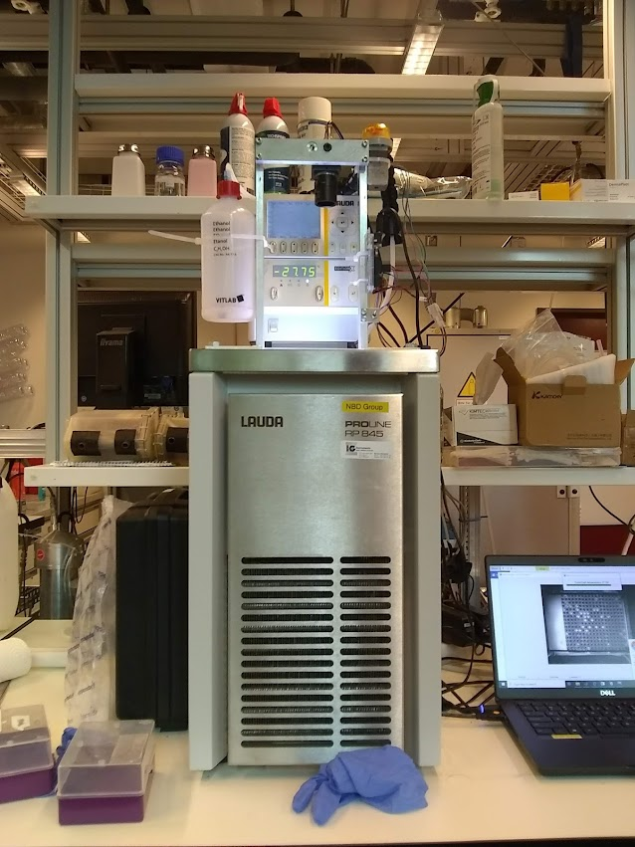
Atmospheric Ice Nuclei

Slide 2
Motivation
Clouds need to contain some fraction of ice particles in order to precipitate (rain or snow)
Water doesn’t freeze at 0 C, to the dismay of atmospheric scientists
Theory says ~ -38 to -40 but measurements are all over the place
Inhomogeneities (dust) in clouds is important
Implications for climate change, weather forecasting, and restoring my sanity

Slide 3
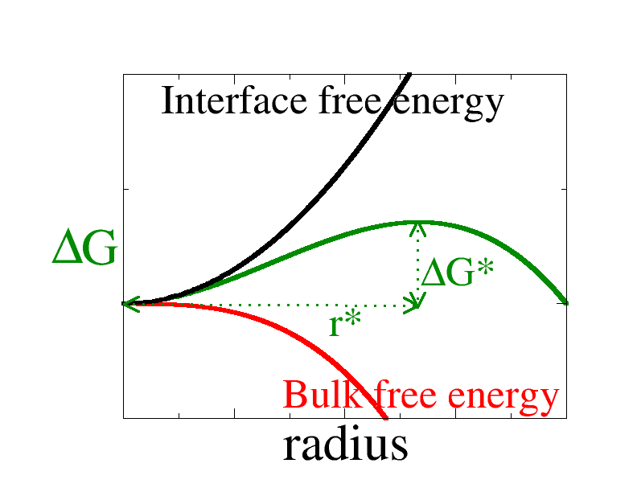
Supercooling, Surface Tension, and Stat Mech
- Free energy of seed crystals is a battle between surface tension (penalty) and volume (benefit).
- Ice crystals need to be “big” in order for the phase transition to occur spontaneously

Slide 4
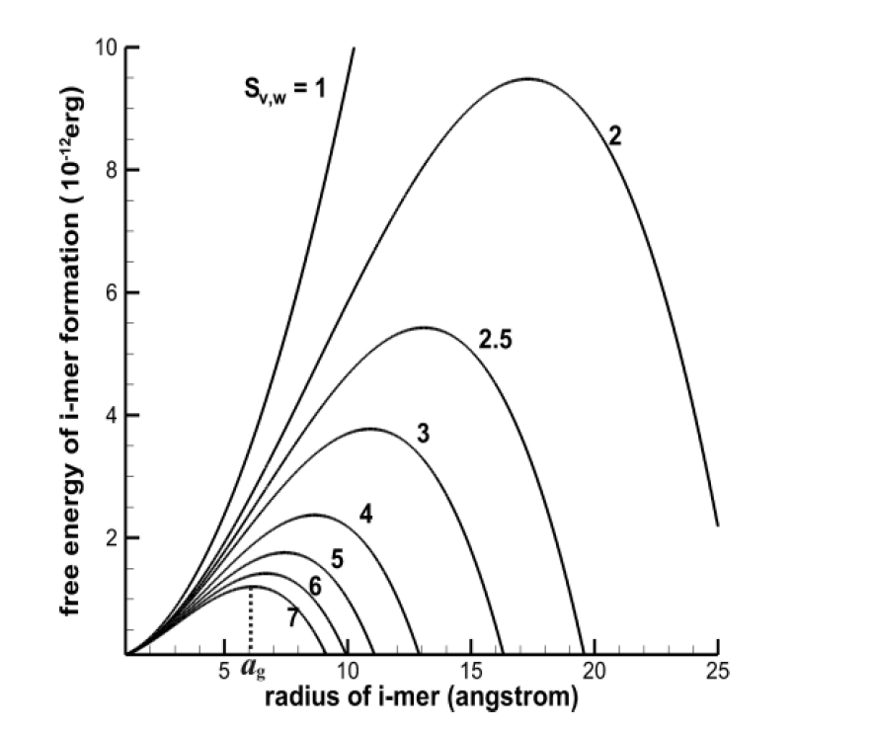
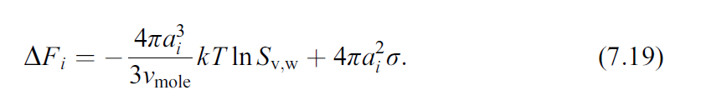
Free energy required to form a seed crystal:

Slide 5
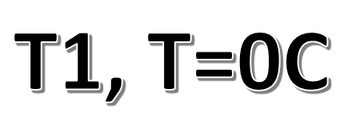
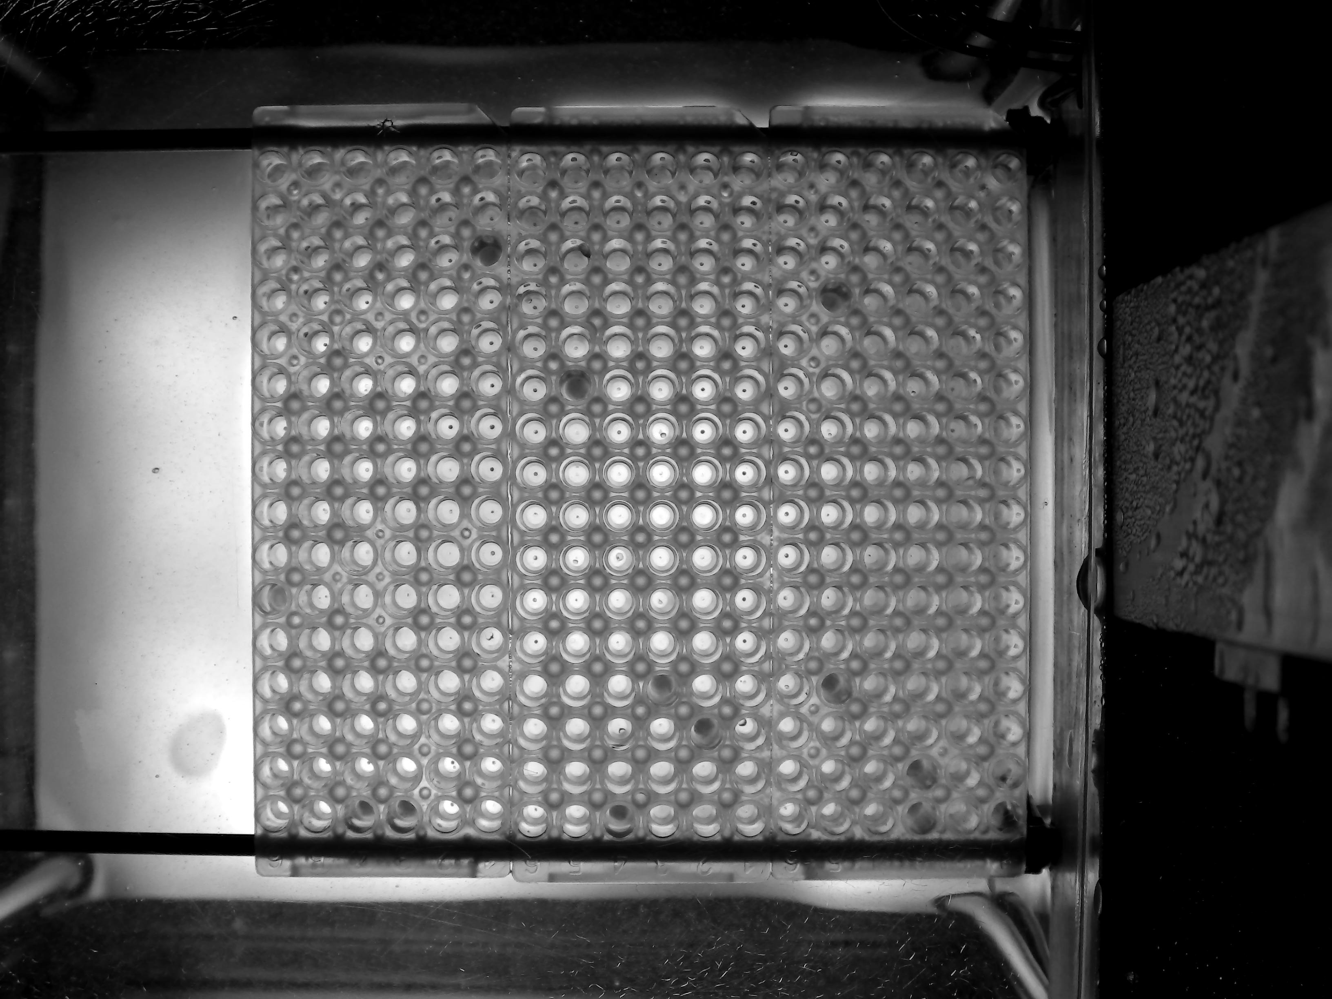
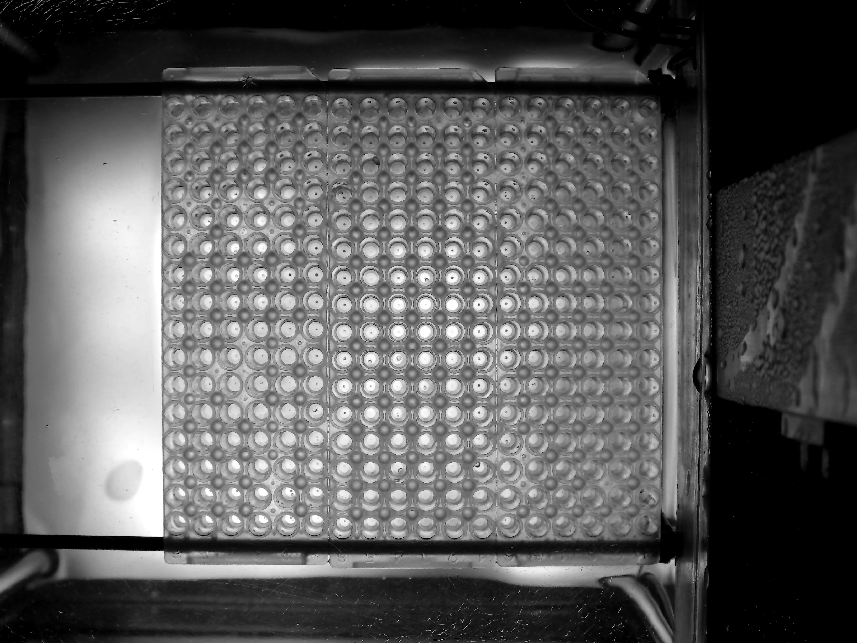
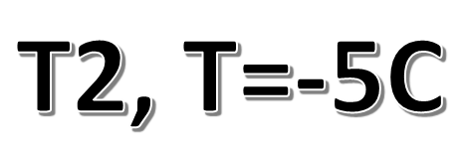
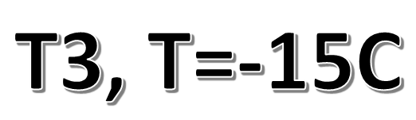
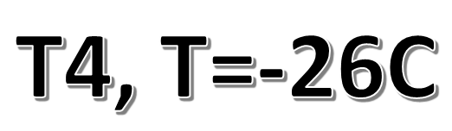
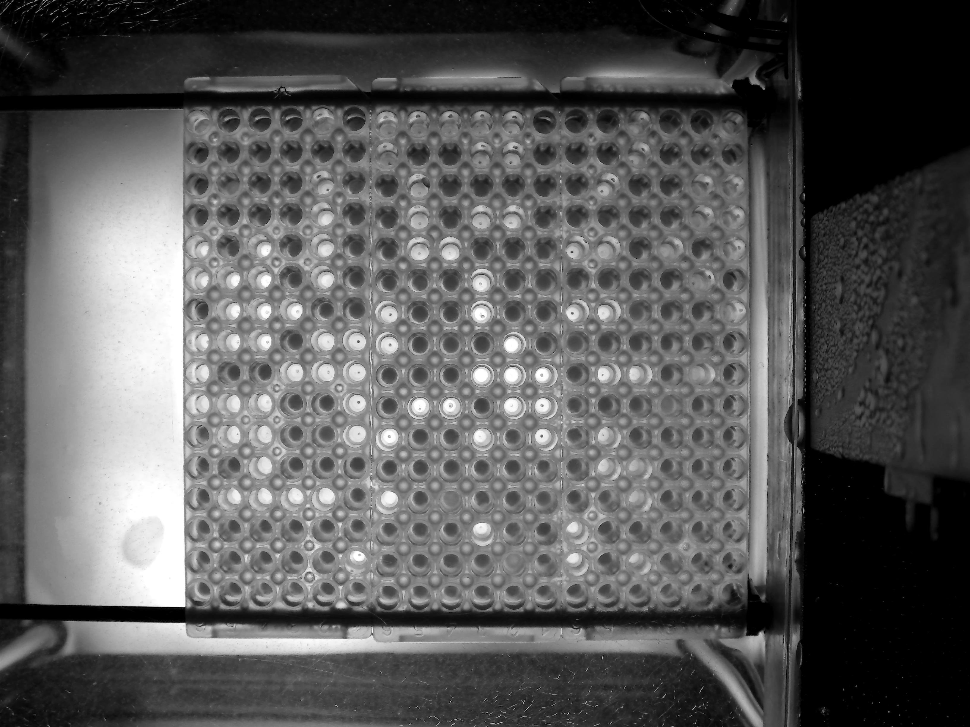
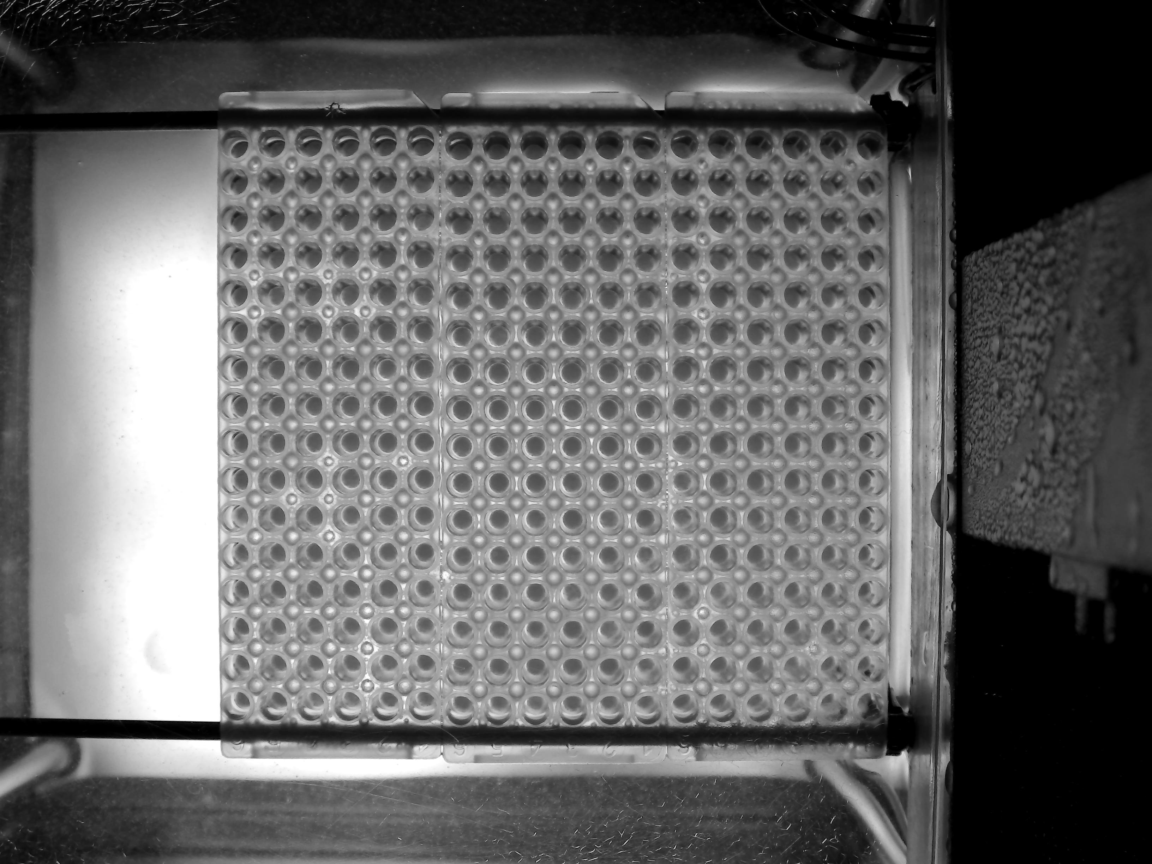

Slide 6
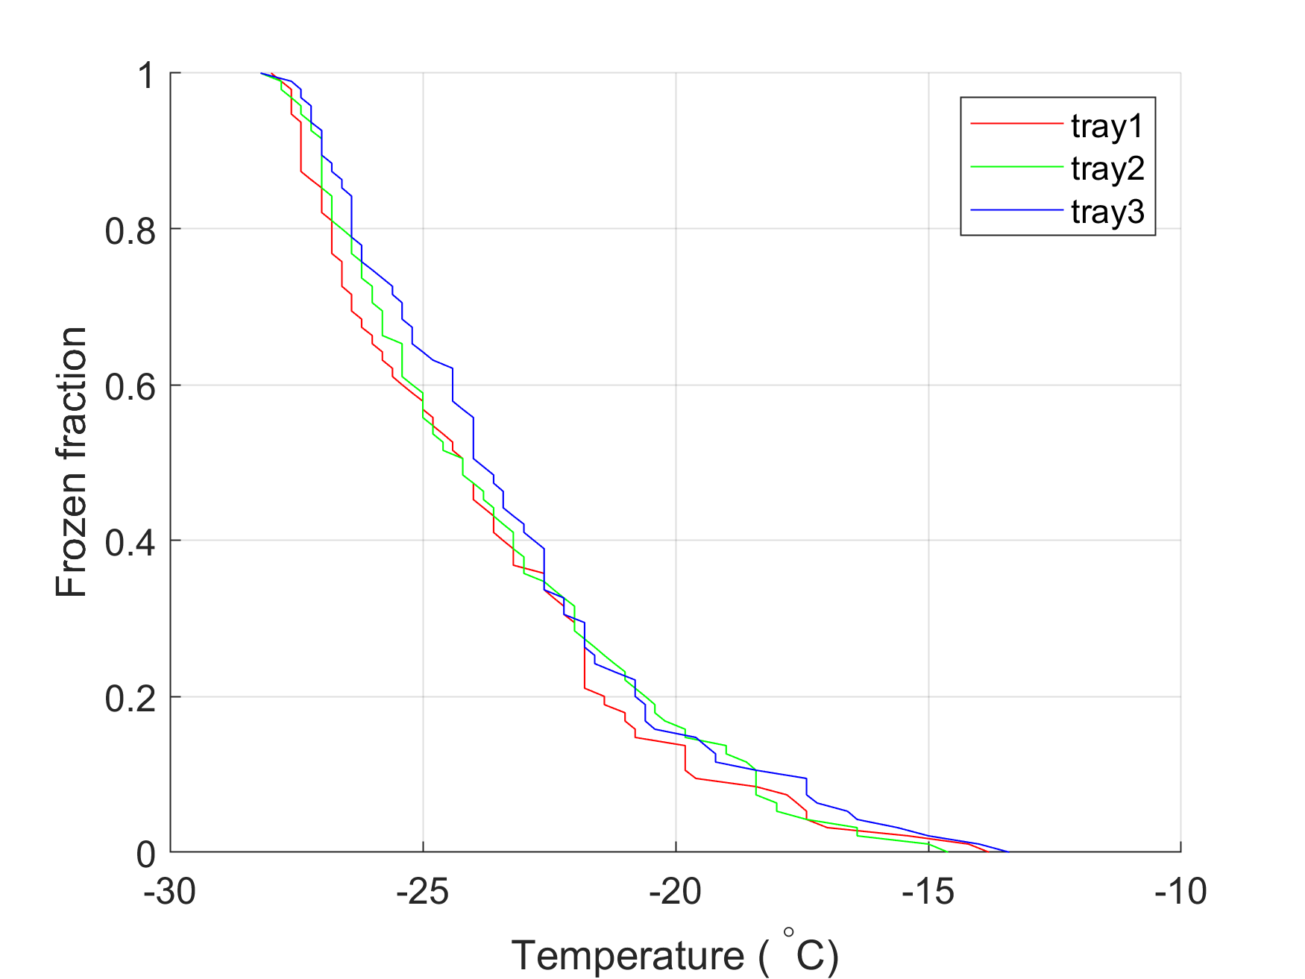
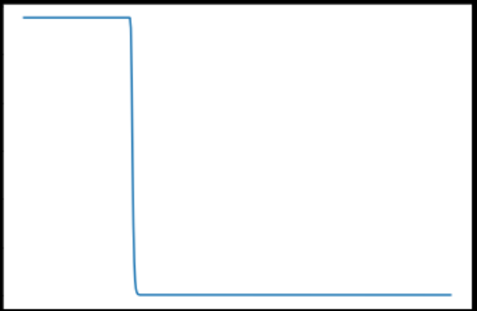
Output of experiment
Lower the temperature 1K/min, observe the number of frozen wells
Get the frozen fraction as a function of (T, t)
“Should” be colder and steeper for pure water

Slide 7
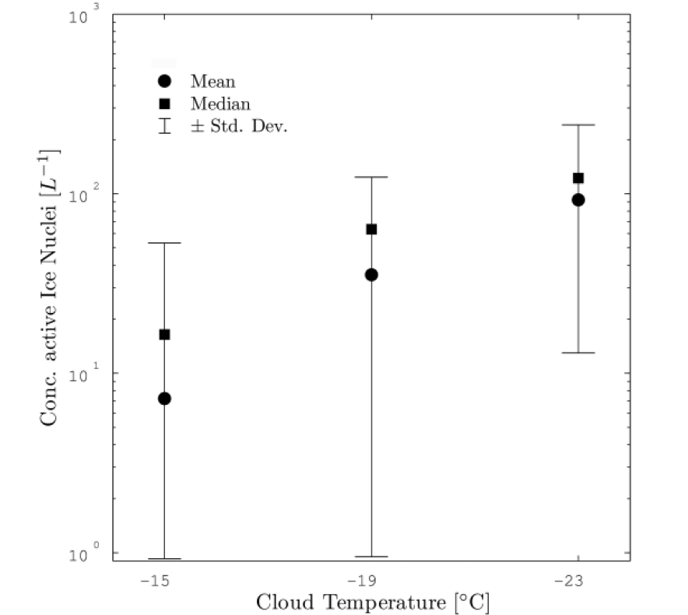
My current Bayesian prior reflects a high state of ignorance
Look at the size of the error bars. Also consider they are log scaled…
New particles to be discovered! Low hanging fruit?

